Slide 1
Assured contract farming system for stable market access
DEPARTMENT OF AIML (AIM) – IV-II Sem Project Review
Project batch No: 07
PROJECT BY: PROJECT GUIDE:
TL: B.Urdhva Sri(21BQ1A6106) Mrs.K.Sireesha
TM1: B.Nagaraju( 21BQ1A6108)
TM2: Durga Bhavani ( 22BQ5A6103)
TM3: M.Srinivas (21BQ1A6135)

Slide 2
CONTENTS
Abstract
Introduction
Existing system
Proposed system
Visualization
Objective
Applications

Slide 3
Abstract
Farmers frequently deal with the unpredictability of market access, which can cause their incomes to fluctuate.
Contract farming offers a solution by providing farmers with guaranteed buyers for their produce, thereby stabilizing their income.
To address this, we propose developing a comprehensive platform that facilitates assured contract farming agreements between farmers and buyers.
This platform will feature tools for transparent communication, secure contract management, and timely payments, ensuring farmers have a reliable market for their crops. The expected solution is an online marketplace that connects farmers with potential buyers.
It will include features for contract management, price negotiation, and secure payment processing. This will help enhance income stability for farmers and reduce market risks. By providing a reliable and efficient way for farmers to secure contracts and ensure timely payments, this platform aims to foster a more stable and predictable agricultural market.

Slide 4
INTRODUCTION
The main purpose behind our project “ASSURED CONTRACT FARMING FOR STABLE MARKET ACCESS” is to address the challenges of farmer selling the product and contractor buying the product from the farmer.
Farmers often face unpredictable market access, leading to fluctuating incomes and financial instability.
Contract farming presents a solution by ensuring guaranteed buyers for their produce. However, traditional contract farming lacks transparency and efficiency.
To address this challenge, we propose an innovative digital platform that connects farmers with buyers through secure and transparent contract agreements. This platform will streamline contract management, price negotiation, and payment processing, ensuring income stability for farmers while reducing market risks.

Slide 5
Existing System
Currently, farmers face several challenges in securing stable markets for their produce:
Unpredictable Market Access – Farmers rely on open markets, middlemen, or local traders, often receiving low and fluctuating prices.
Lack of Transparency – Traditional contract farming agreements are often informal, leading to disputes and delayed payments.
Payment Insecurity – Farmers face delays or non-payment due to weak enforcement of agreements.
Limited Buyer Reach – Farmers struggle to connect with reliable buyers, limiting their ability to negotiate better prices.
Inefficient Communication – Manual negotiations and contract management lead to delays and misunderstandings.

Slide 6
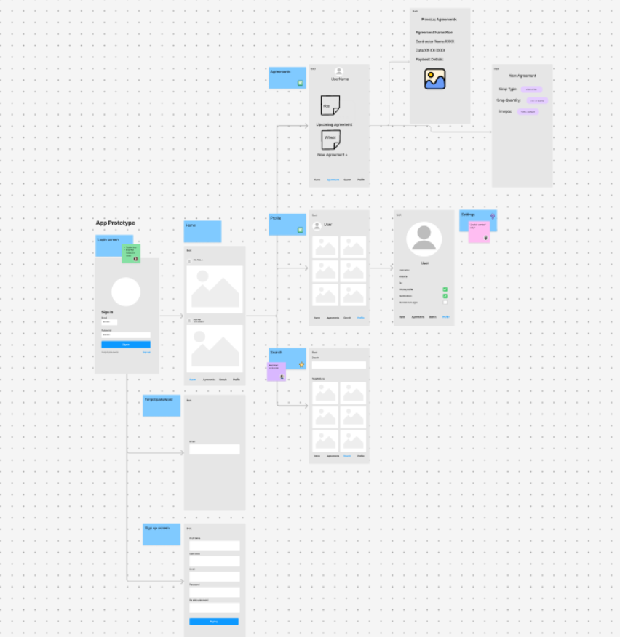
Proposed system

Slide 7
THANK YOU

